Slide 1


UP, UP and AWAYYY
Project Team
Jared Nieves
Melinda Eudy
Sarah Green
Zehra Tokatli

Slide 2

PROJECT BACKGROUND

Slide 3

Atlanta and Los Angeles.
Being two of the busiest airports in the country and ones that carry a heavy load of international travel.
We wanted to dive into the data to see which countries are flying the most into the two airports.

Slide 4
Questions To Answer
✈️ Which country flies into Atlanta airport the most and which flies in the least?
✈️ Which country flies into Los Angeles airport the most and which flies in the least?

Slide 5
DATA SOURCES & ETL PROCESS

Slide 6
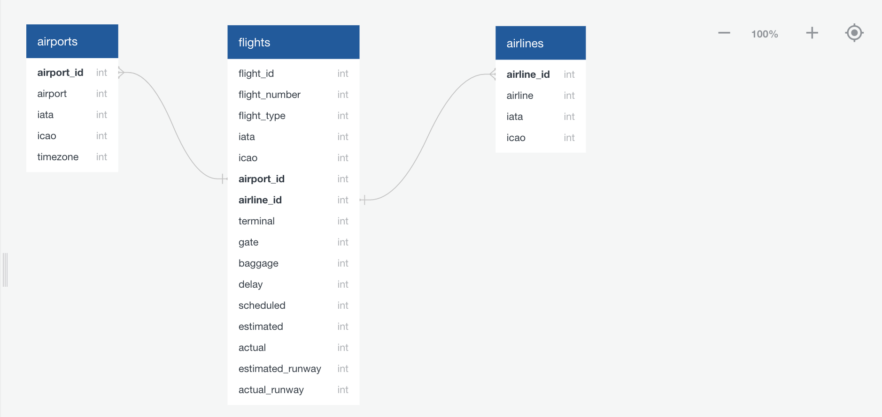
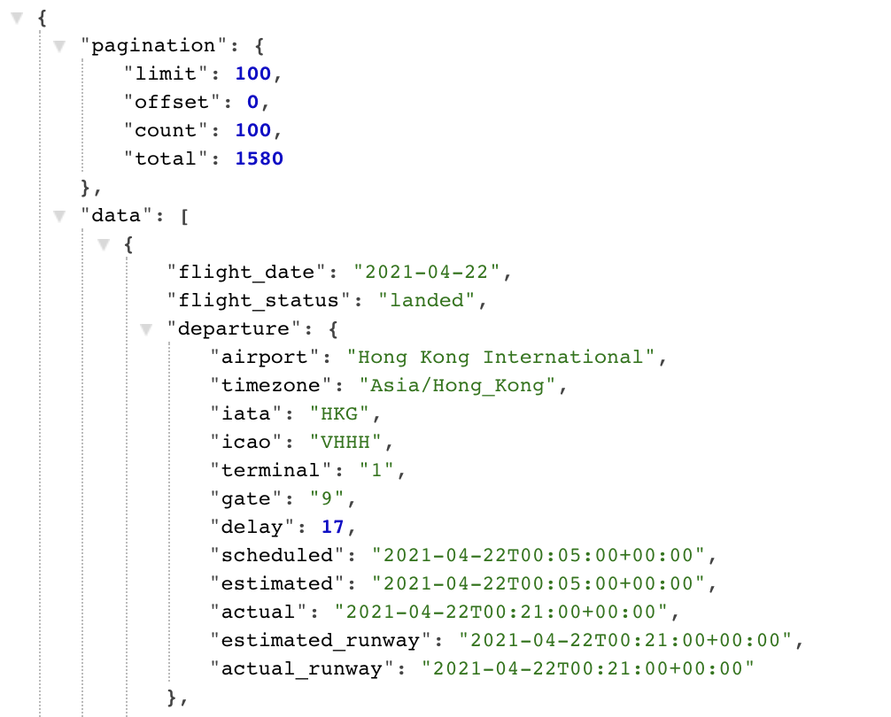
The team leveraged an JSON formatted API from api.aviationstack.com/ containing flights provider information including airports, airlines and flights information.
ERD diagram supported the database construction of there tables on aviation schema on PostgreSQL.

Slide 7
FLASK & PAGE VISUALS

Slide 8
Team used the power of D3 for creating visualizations by binding the data and graphical elements.
We were used Flask API of Python that allows us to build up our simple web application for to analyze aviation information’s with interactive graphics.
As you will see we can choose between Los Angeles IA and Atlanta - Hartsfield-Jackson IA airports.

Slide 9
HEROKU

Slide 10
Aviation analyze webpage hosted and published by using with Heroku cloud platform.
up-up-awayyy.herokuapp.com

Slide 11

Thank You
Q & A

